Slide 1


Slide 2

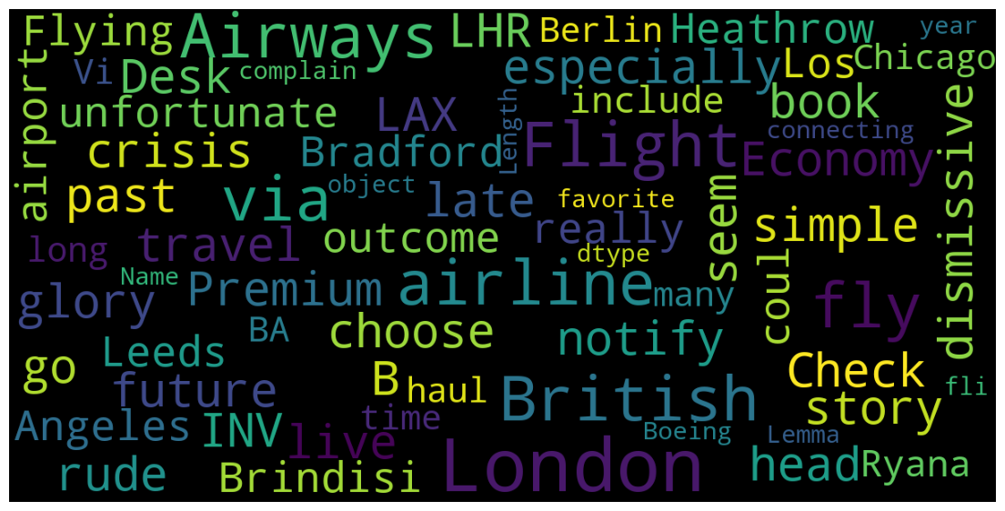
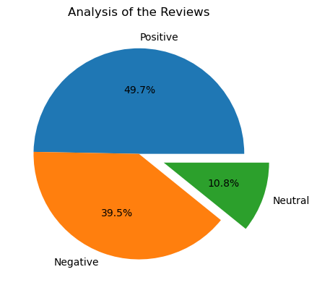
INSIGHTS GAINED FROM THE REVIEWS FROM THE CUTOMERS
FROM THE REVIEWS OF CUSTOMER:
Positive reviews : 497
Negative reviews: 395
Neutral reviews: 108

